Slide 1

Conjunctivitis
Supervised by:
Dr: Heba Zaki
TA: Nora abdelhameed

Slide 2
Bioservers Project
Team Members:
1-Heba Mohamed Fahmy 20198096
2-Joya Gamal Moussa 20198023
3-Maha Ahmed Yehia 20198087
4-Mohamed Salah 20198073
5-Osama Mokhtar 20198109

Slide 3

Conjunctivitis
Conjunctivitis, also known as pink eye, is inflammation of the outermost layer of the white part of the eye and the inner surface of the eyelid. It makes the eye appear pink or reddish. Pain, burning, scratchiness, or itchiness may occur.

Slide 4
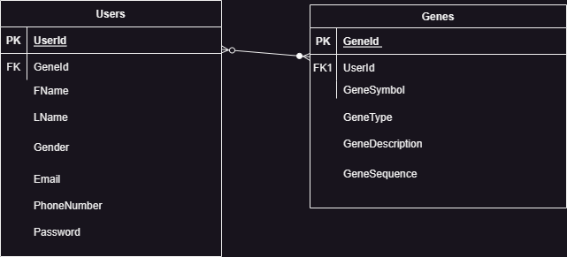
Database Schema

Slide 5
Implemented Functions
1-Complement
2-Reverse Complement
3-Translation
4-Transcription
5-Reverse Transcription

Slide 6

User Flow
Conjunctivitis Info
Home

Slide 7
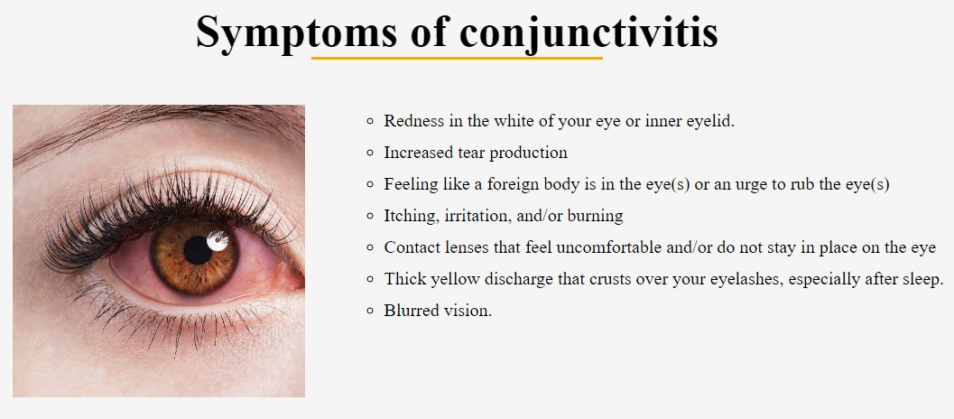
Symptoms

Slide 8
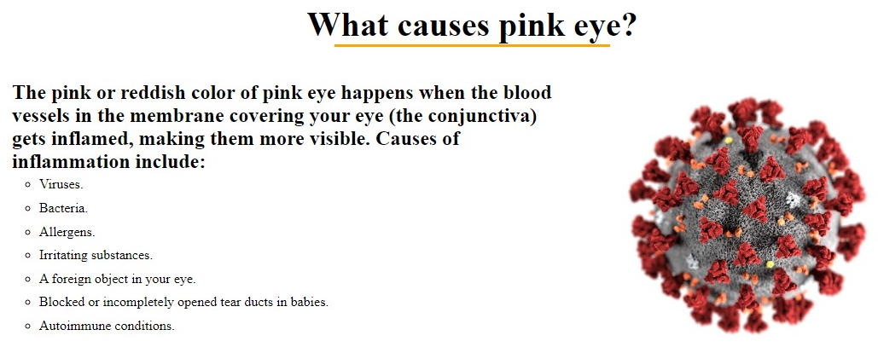
Causes

Slide 9
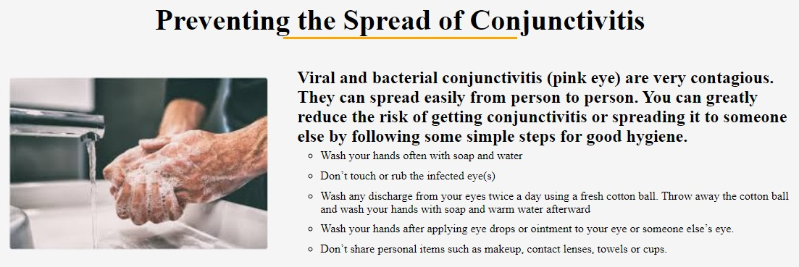
Prevention

Slide 10
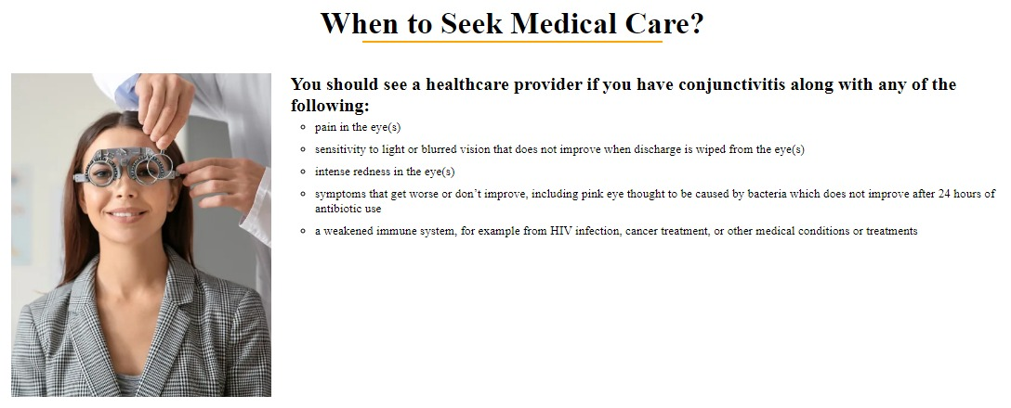
Medical Care

Slide 11
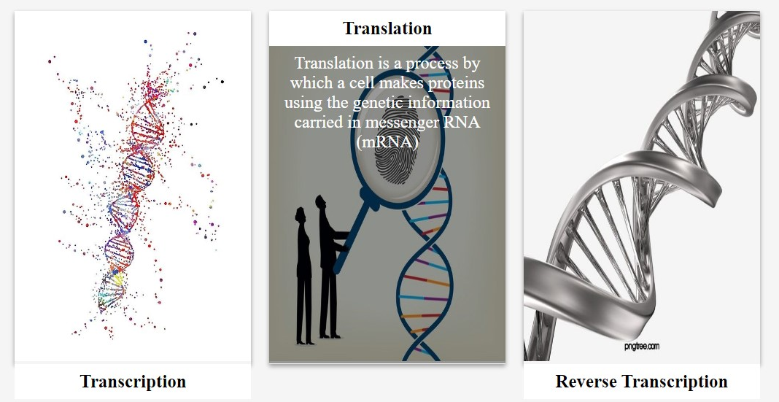
Services

Slide 12
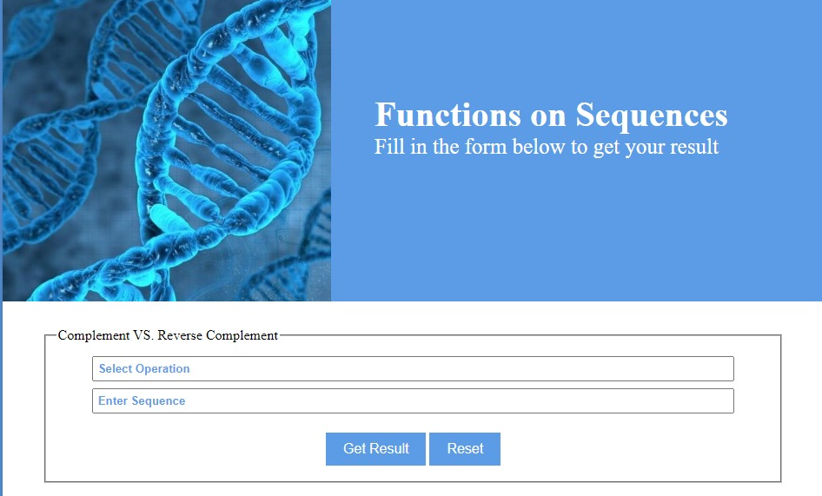

Slide 13
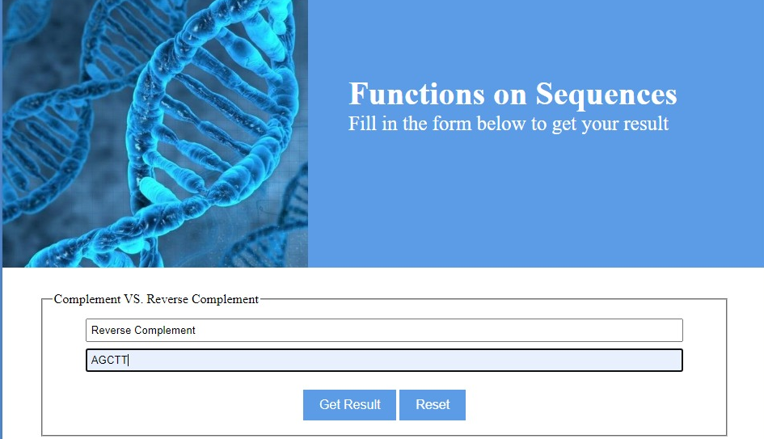

Slide 14


Slide 15
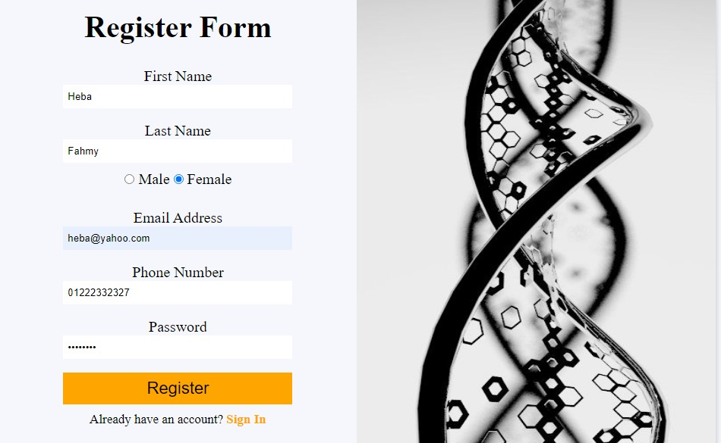
Database Genes
Account

Slide 16
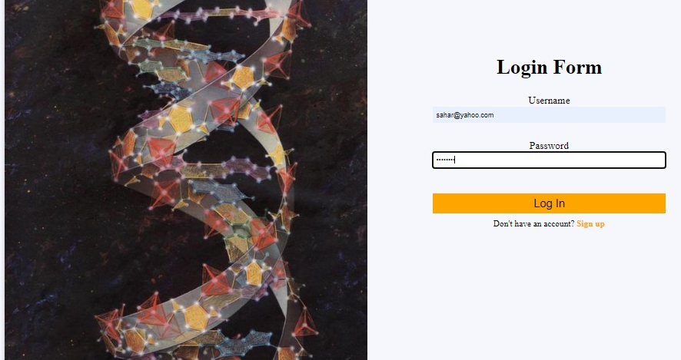
Account

Slide 17
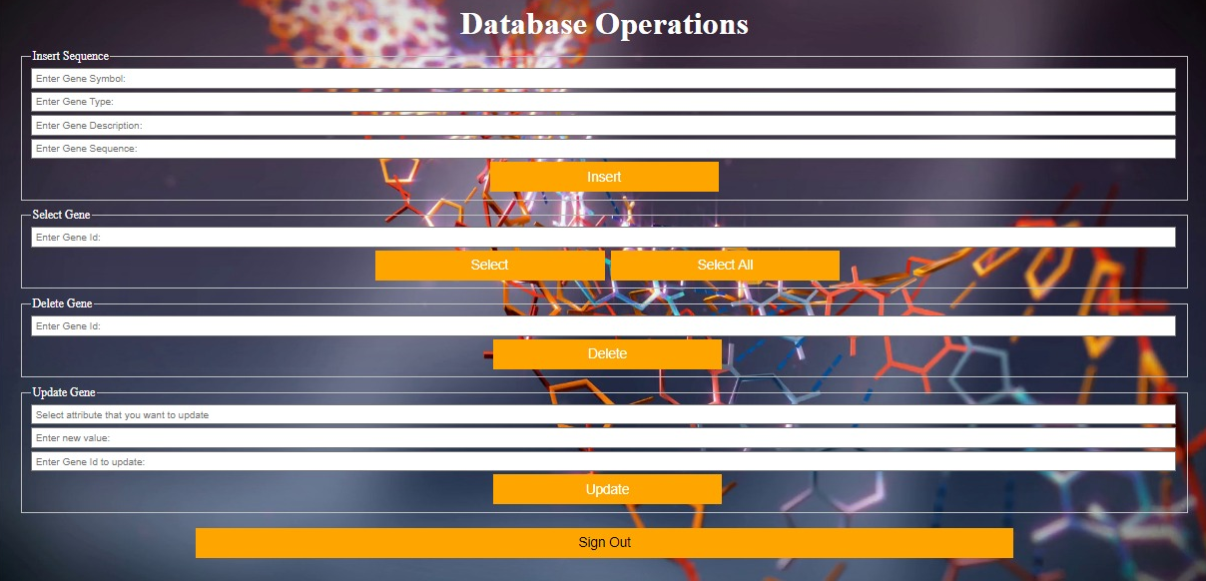
Database Operations

Slide 18
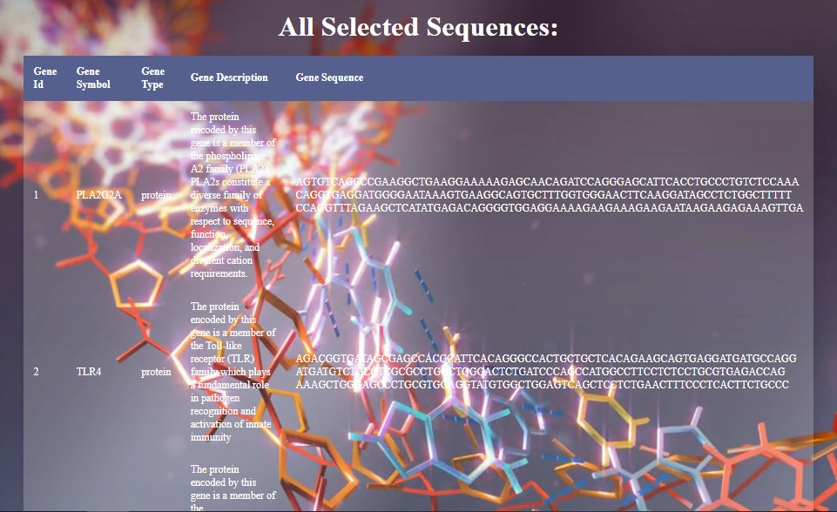

Slide 19
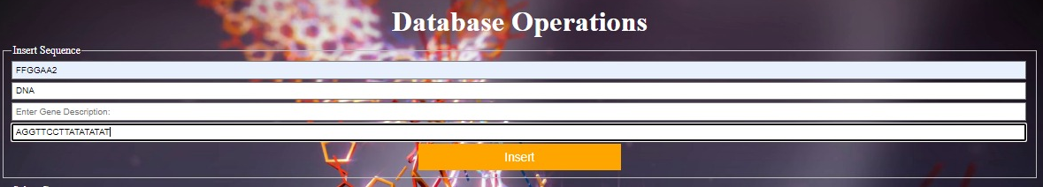

Slide 20


Slide 21


